Slide 1


Slide 2
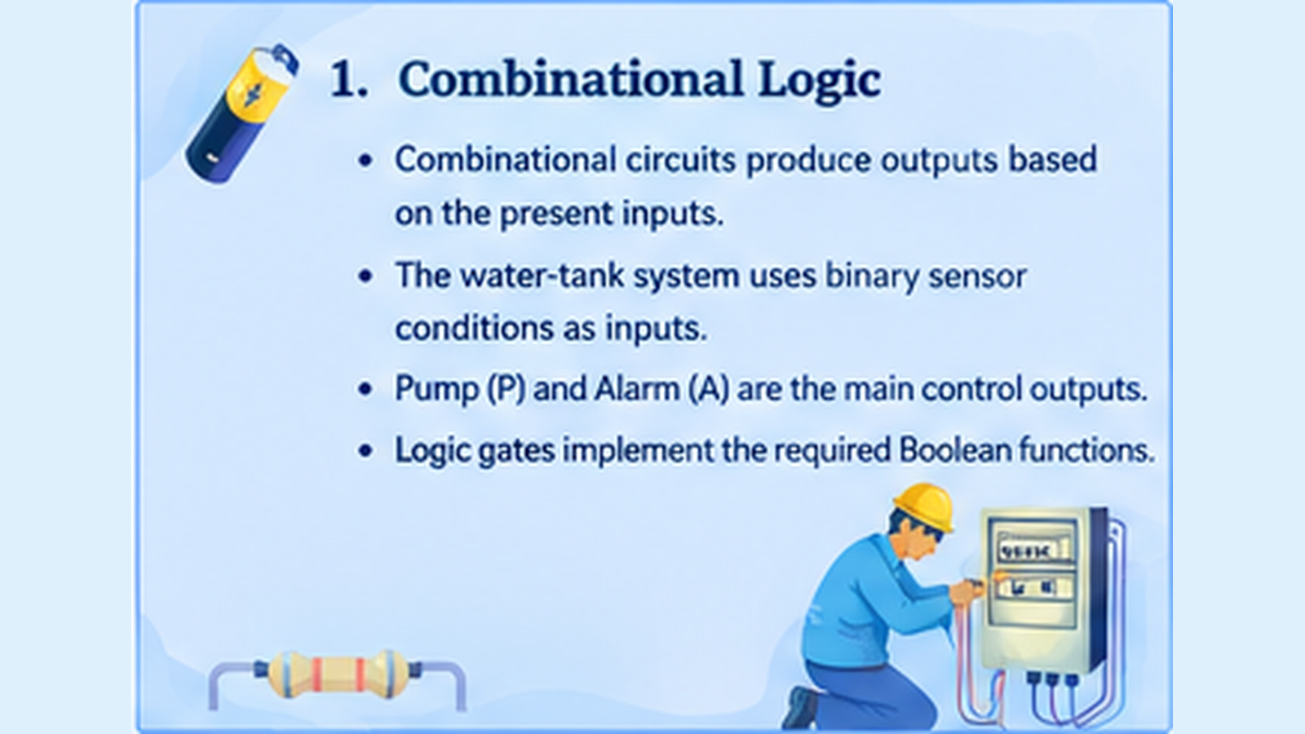

Slide 3
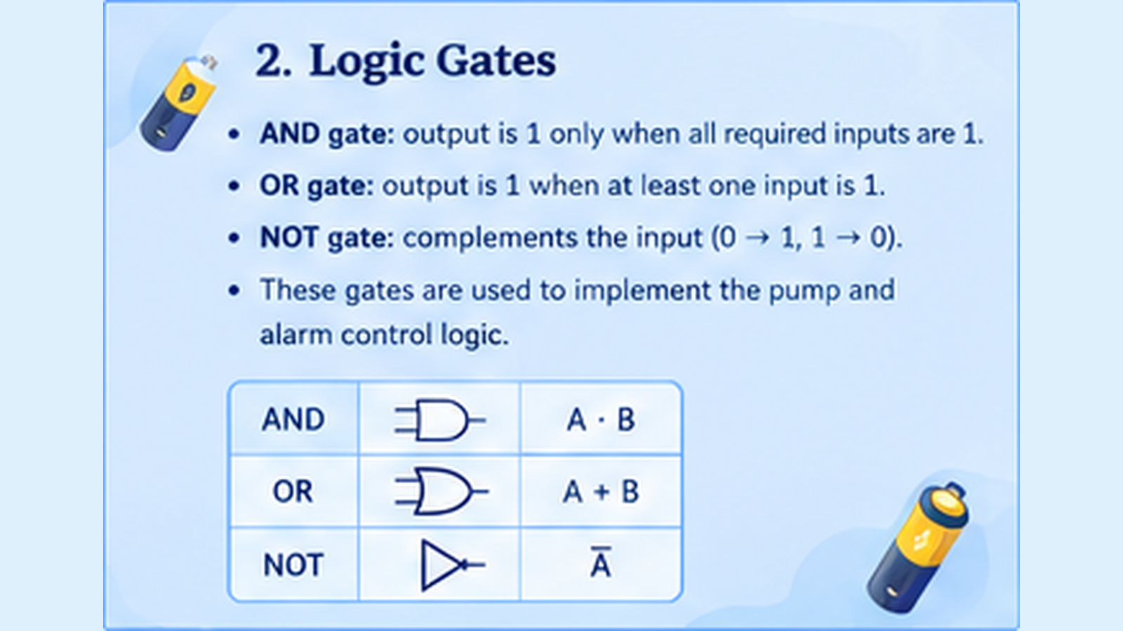

Slide 4
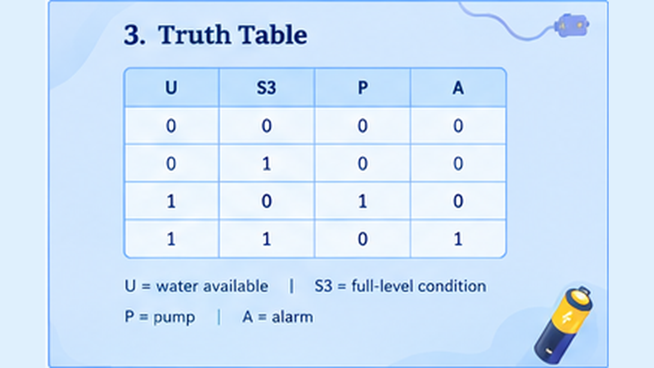

Slide 5
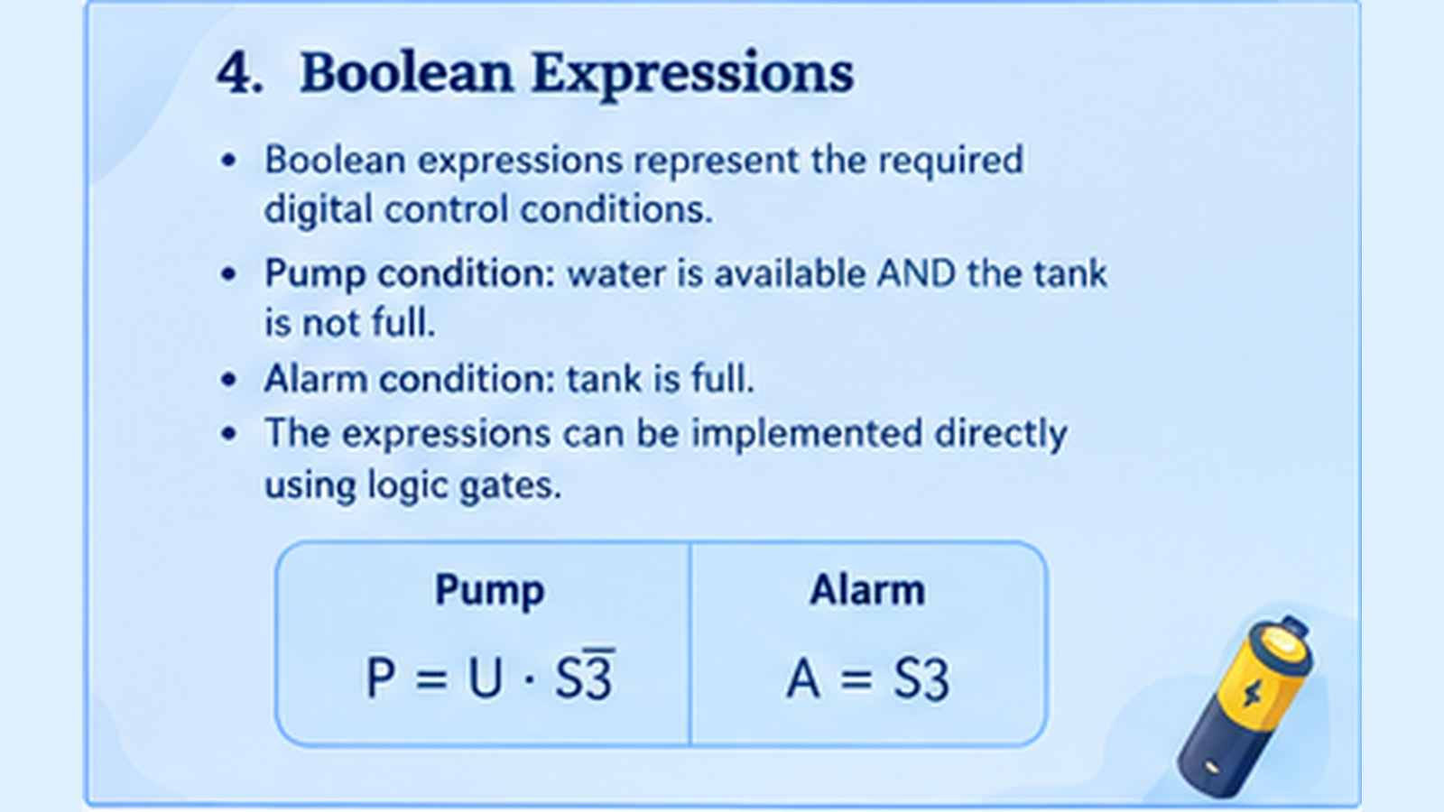

Slide 6
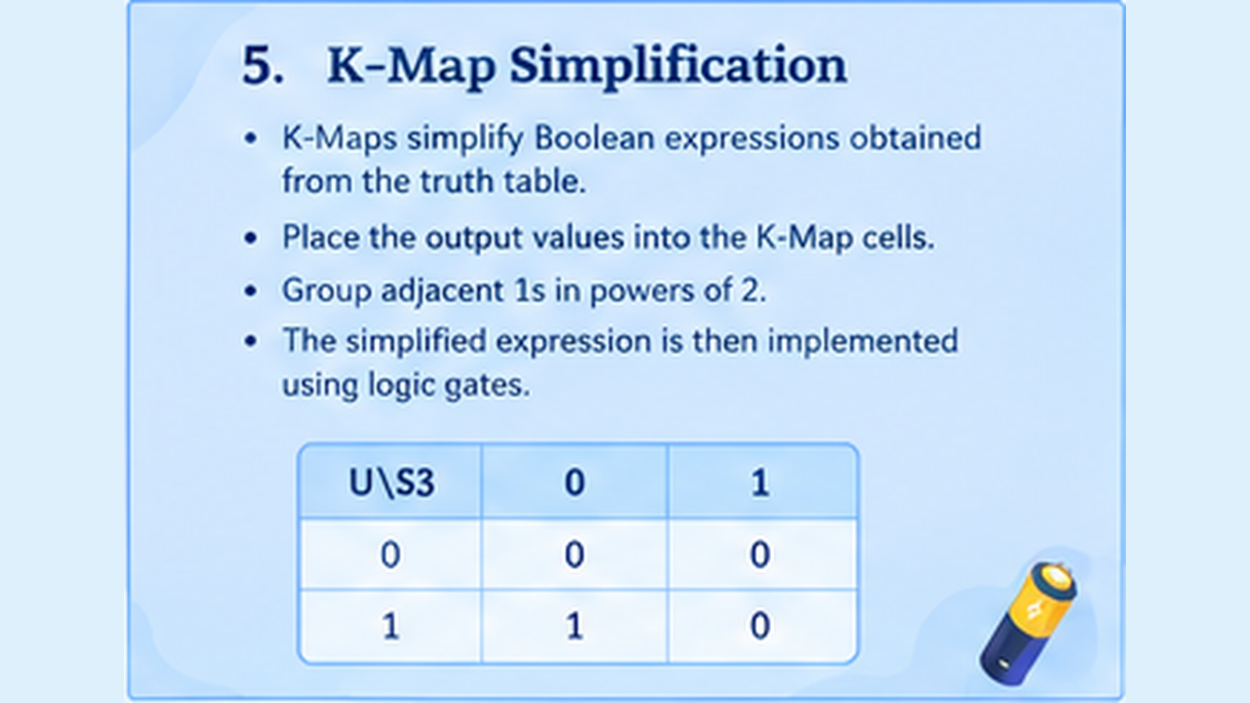

Slide 7
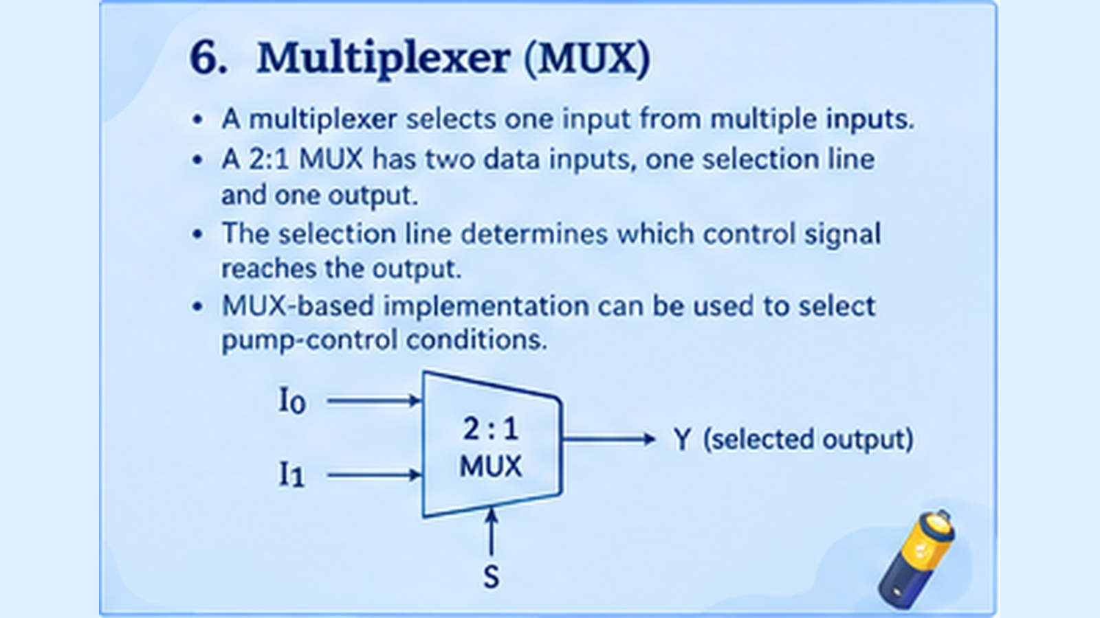

Slide 8
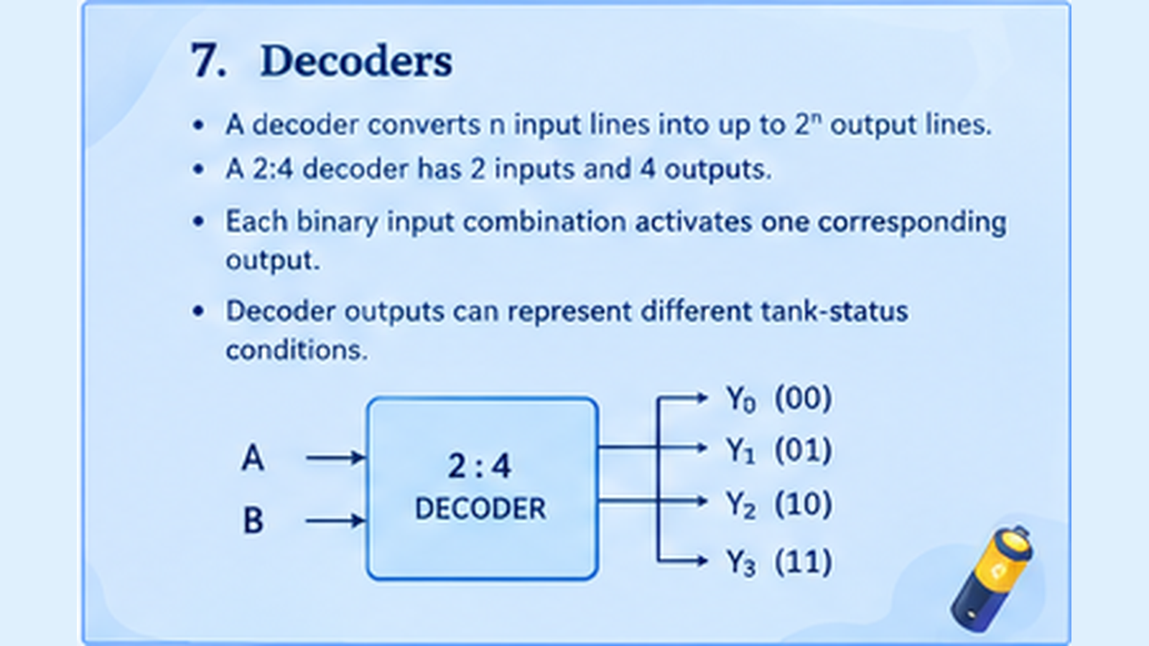

Slide 9
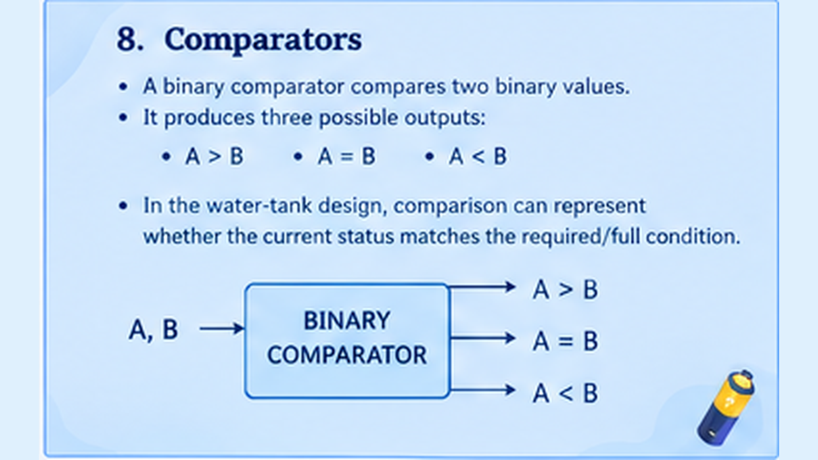

Slide 10
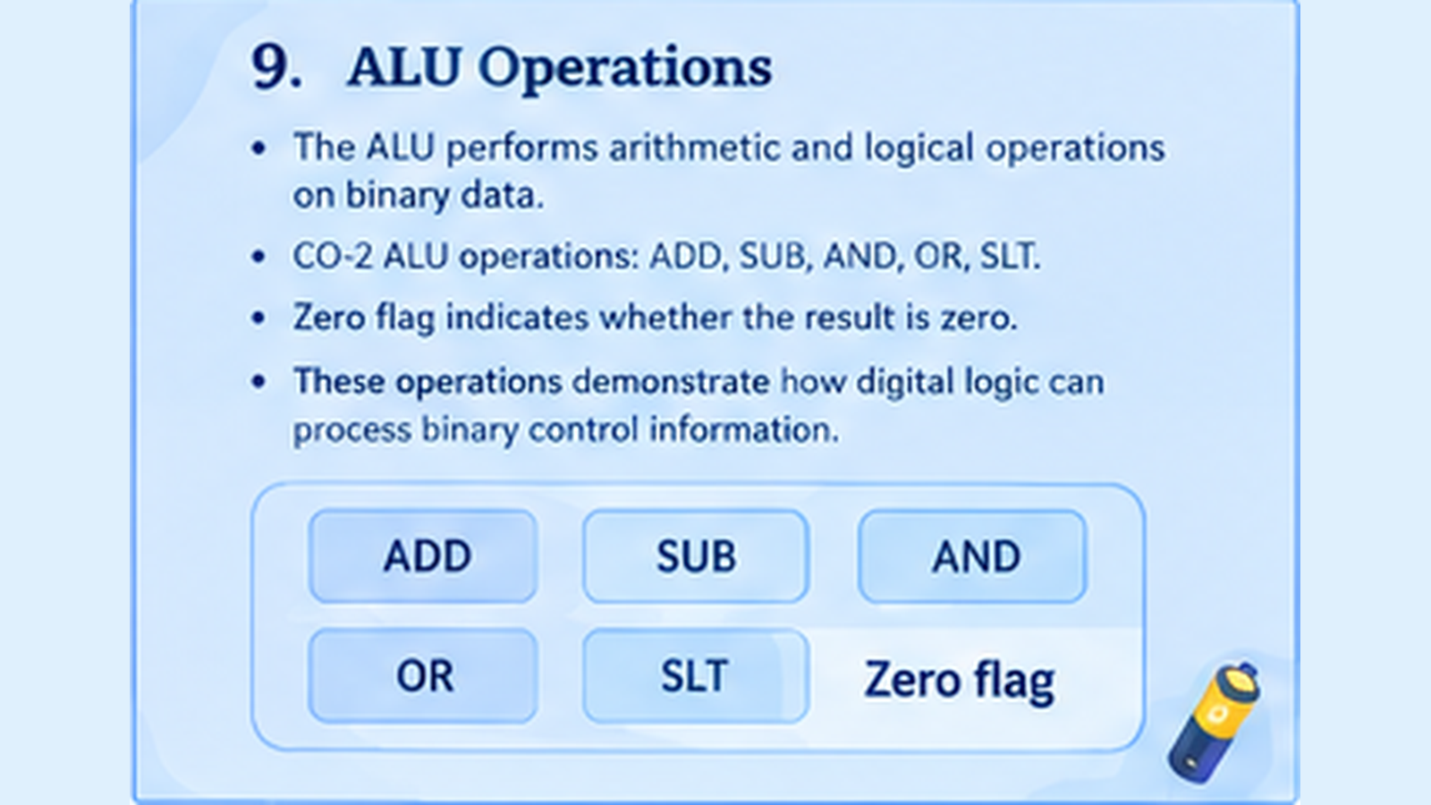

Slide 11
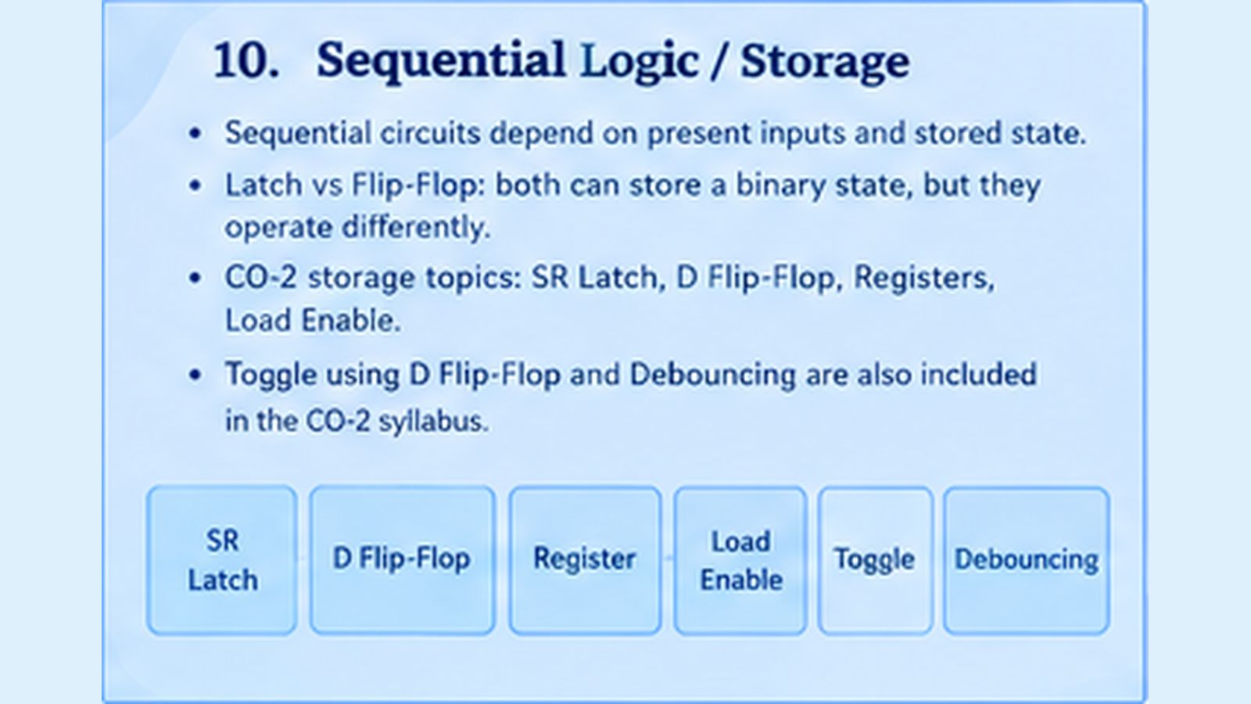

Slide 12
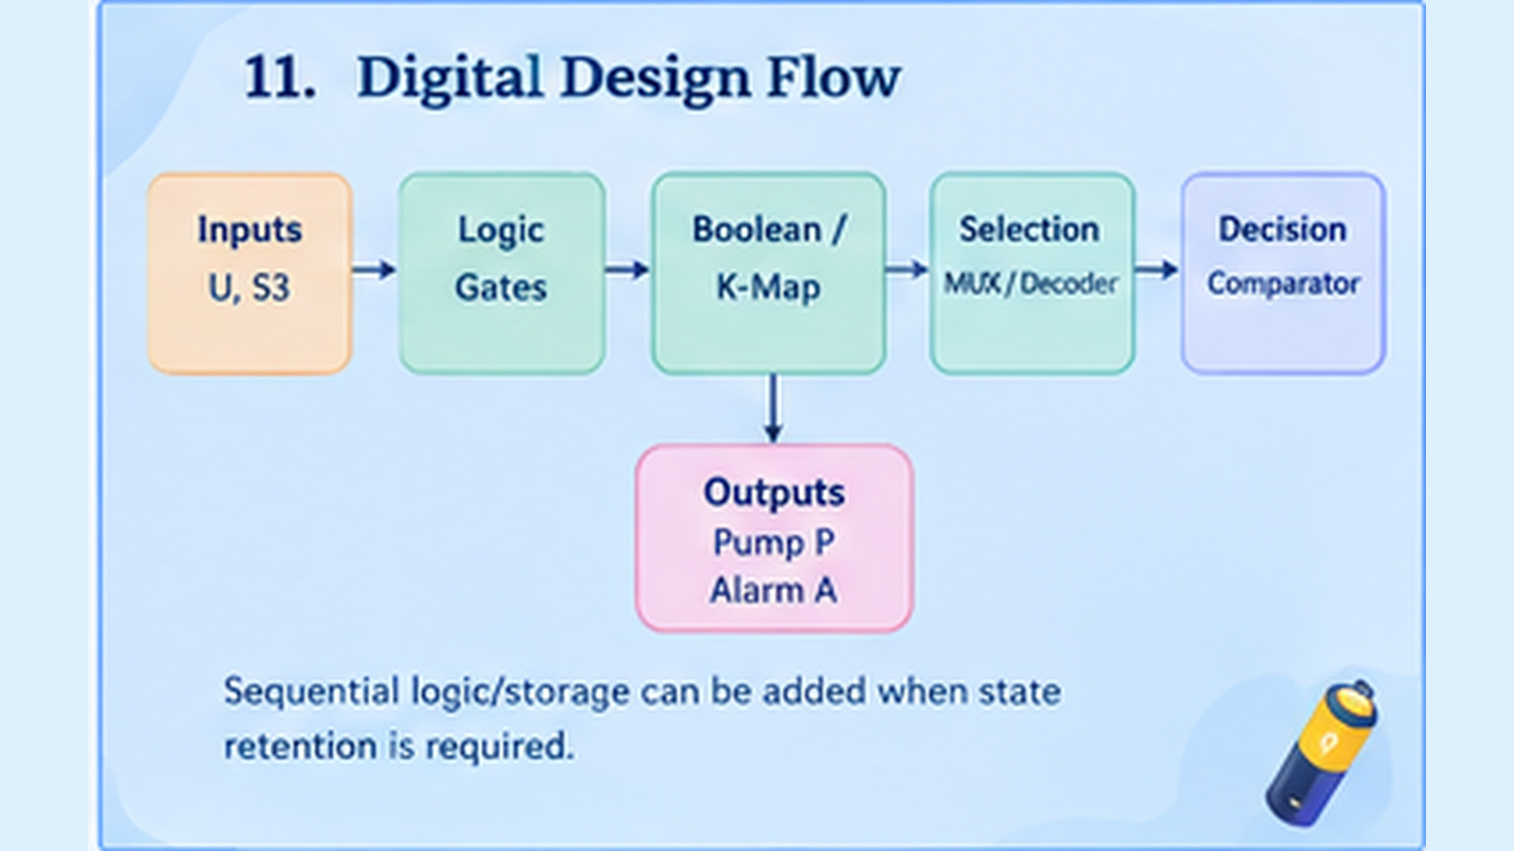

Slide 13
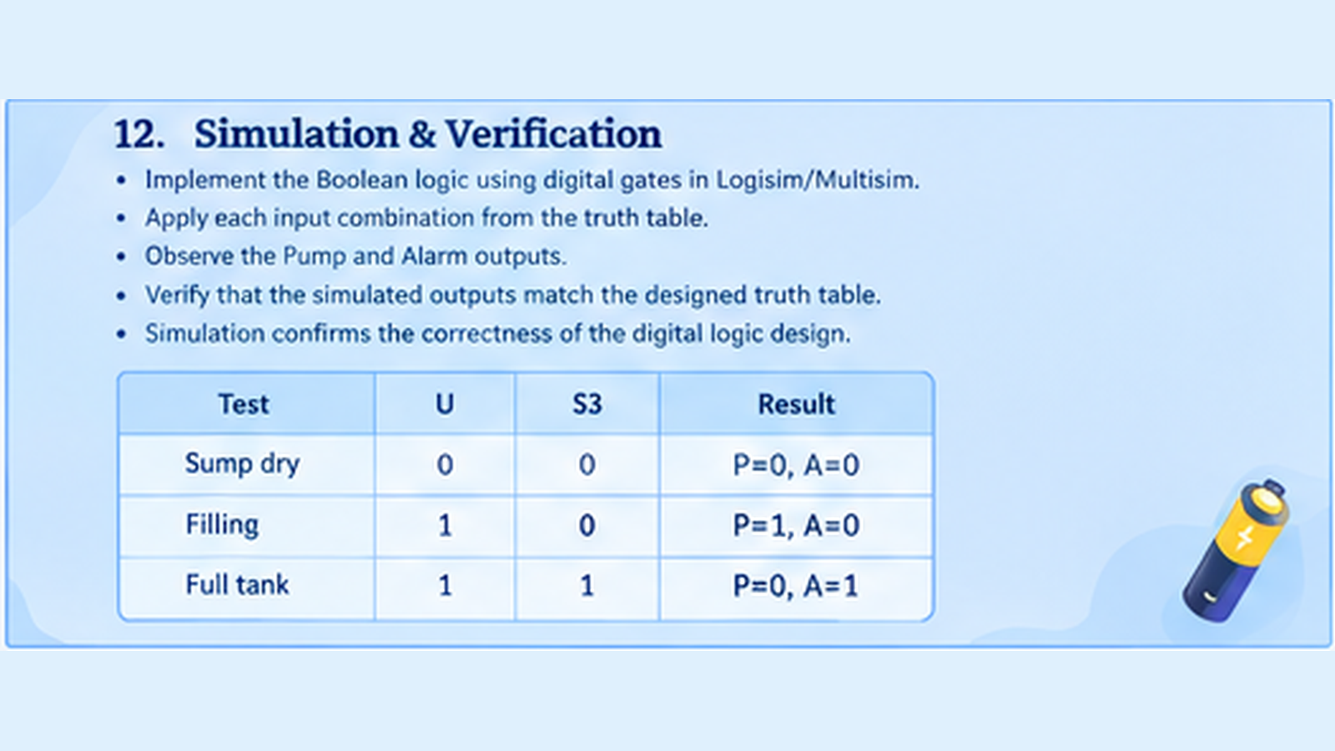

Slide 14

13. System Architecture
Sensors
Logic Unit
Controller
Outputs
Water availability (U)
Full-level condition (S3)
AND / NOT gates
Boolean expressions
MUX / Decoder
Decision logic
Pump (P)
Alarm (A)
The system moves from sensor inputs through digital logic to final control outputs.
The modular structure makes the design easier to test and expand.

Slide 15
14. Hardware Components
Water-Level Sensor
Logic / Controller
Pump Driver
Alarm
Processes the binary sensor
signals.
Interfaces the control signal
with the pump.
Indicates the full-tank condition.
Detects water availability and the full-tank condition.
Stable power and correct wiring support reliable operation.
Sensor placement should accurately represent the intended tank levels.

Slide 16
15. Control Algorithm
1. START
4. ACT
2. READ
3. CHECK
Initialise sensors and outputs.
Read U and S3.
Evaluate the Boolean conditions.
Update Pump and Alarm.
Repeat continuously: read sensors → evaluate logic → update outputs → repeat.
Pump: P = U · S3̅
Alarm: A = S3

Slide 17
16. Expected Simulation Results
Tank condition | U | S3 | Pump P | Alarm A
No water / sump dry | 0 | 0 | 0 | 0
Water available, not full | 1 | 0 | 1 | 0
Full-level condition | 1 | 1 | 0 | 1
Use these cases as a verification checklist in Logisim/Multisim.
The simulated outputs should match the designed truth table.

Slide 18
17. Applications, Advantages & Future Scope
Applications
Advantages
Future Scope
Domestic overhead tanks
Apartment water systems
Irrigation storage
Industrial water management
Overflow protection
Reduced unnecessary pump operation
Simple digital control
Easy simulation and verification
Multiple level sensors
IoT monitoring
Mobile alerts
Fault detection and logging
The same digital-logic foundation can be extended to a connected smart-water system.

Slide 19
18. Conclusion
The project applies CO-2 concepts of combinational logic, Boolean expressions, truth tables, K-Maps, and logic gates .
MUX, decoder comparators demonstrate additional digital design techniques.
ALU and sequential-logic concepts connect the project with other topics in Digital Design and Computer Architecture.
The designed logic provides automatic pump control and overflow alarm based on the water-level conditions.
Simulation and verification confirm that the designed outputs match the required truth table.
The system can be further improved with multiple sensors, IoT monitoring, mobile alerts, and fault detection.

